Slide 1
Apache Spark
Unmesh Deodhar
Shraddha Zingade

Slide 2
Apache Spark

Slide 3
Overview:
Own by Apache.
Open source cluster computing framework.
Framework used for managing big data processing requirements with wide variety of data sets.
Extends MapReduce for more type of computations.
Type of data: graph data, text data, real time data.
Notes:
More type of computations means interactive queries, stream processing, graph data, text data and real time data.

Slide 4
Features:
In memory cluster computing.
Flexibility for programmers.
Supports wide variety of data formats.
Programmers can modify the data in real time through spark streaming.
Notes:
It stores the intermediate processing data in its memory instead of on the disk, thus reducing the number of read-write operations on disk.
This increases the speed by 100 times when running in memory and by 10 times while running on disk.
Flexibility - Java, Scala, Clojure, R or Python.

Slide 5
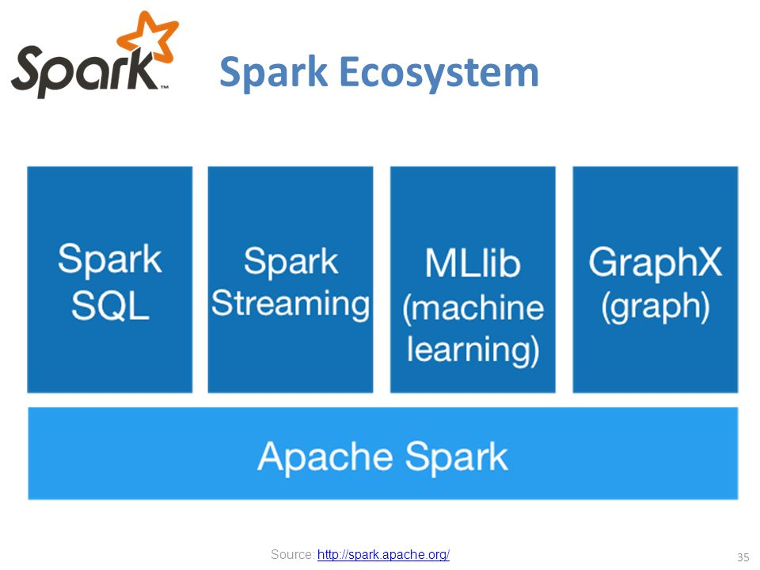
Spark Ecosystem:

Slide 6
Spark SQL:
Provides ETL for different data formats.
Allows SQL like queries on data.
Allows users to extract using SQL, transforms it and loads it for any language based querying.

Slide 7
Spark Streaming:
Used for real time streaming of data.
Takes data in mini-batches.
Performs Resilient Distributed Dataset transformation.
Takes data and divides into logical partitions.
RDD is a read-only, portioned collection of records. Using this feature, operations can be executed on the real streamed data.

Slide 8
MLib
Machine learning framework.
Machine learning algorithms such as
Classification
Regression
Clustering
Collaborative filtering
Reduction

Slide 9
GraphX
Collection of graph algorithms.
Operators for graph computations such as
Sub-graph
Join vertices
Aggregate messages

Slide 10
Big Data Processing with Spark

Slide 11
In-memory Computation
In addition, Spark keeps track of the data that each of the operators produces, and enables applications to reliably store this data in memory.
This is the key to Spark’s performance, as it allows applications to avoid costly disk accesses.
Low-latency computations by caching the working dataset in memory and then performing computations at memory speeds.
Efficient iterative algorithm by having subsequent iterations share data through memory, or repeatedly accessing the same dataset

Slide 12
Spark SQL

Slide 13
Introduction
Provides ETL for different formats.
Allows running SQL like queries on data.
User requires less efforts.
Allows user to extract using SQL like queries, transforms it, and loads it into suitable language based querying.

Slide 14
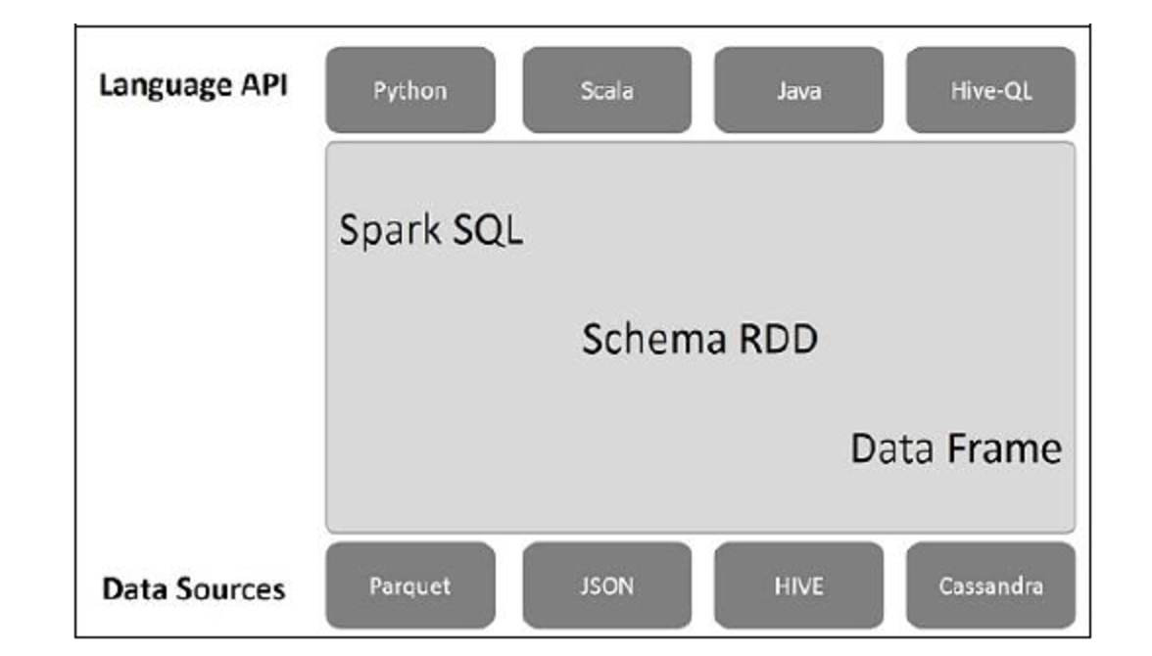
Spark SQL architecture

Slide 15
Main components of Spark SQL
Language API
Schema RDD
Data sources

Slide 16
1. Language API
Spark is compatible with many languages.
It is supported by APIs of
Java
Python
Scala
HiveQL

Slide 17
Schema RDD
Spark is designed with special data structure called Resilient Distributed Dataset(RDD).
Spark works with table, schema and records.
Thus, we need special temporary table.
We call this RDD as data frame.

Slide 18
Data source
As mentioned before, using various types of data sources is one of the advantage of Spark SQL.
Variety of data sources which can be accessed by Spark are-
Parquet file
JSON document
HIVE table
Cassandra database

Slide 19
RELATING SPARK SQL TO SQL

Slide 20
DataFrames
Equivalent to tables in SQL.
It is collection data organized in columns.
Supports multiple data formats.
Processes data in KB to PB in single node cluster.

Slide 21
SQLContext
It is a class which is used for initialization of functionalities of Spark SQL.
SparkContext class object (sc) is required for initializing SQLContext class object.

Slide 22
Example 1
To read JSON file, we first generate a data frame and then read the file.
Attributes are taken automatically from the JSON file.
scala> val dfs = sc.read.json(“foo.json")

Slide 23
SELECT command
SELECT *
scala> dfs.show()
SELECT name
Scala> dfs.select(“name”).show()

Slide 24
Other operations
WHERE operation
scala> dfs.filter(dfs("age") > 23).show()
Group by operation
scala> dfs.groupBy("age").count().show()

Slide 25
Conclusion
In-memory Computation
Flexibility of Programming – Java, Scala, Python, R etc.
Embedding SQL in high level programming languages.
Spark SQL extends Spark with a declarative DataFrame API to allow relational processing.

Slide 26
Questions?

Slide 27
Thank you!

